Slide 1
How to write narrative CVs for funding applications 22 June 2023
Tanita Casci (Research Services) Mary Muers (MSD)

Slide 2
Today’s session
Why narrative CVs are being adopted by many funders
Overview of the narrative CV format
How to write:
Points to remember
Getting started and example structure
Tips for each module
Team CVs
Extra resources
Questions and discussion
Poll
What is your current level of awareness of the narrative CV?
How prepared do you feel to start writing your narrative CV?​

Slide 3
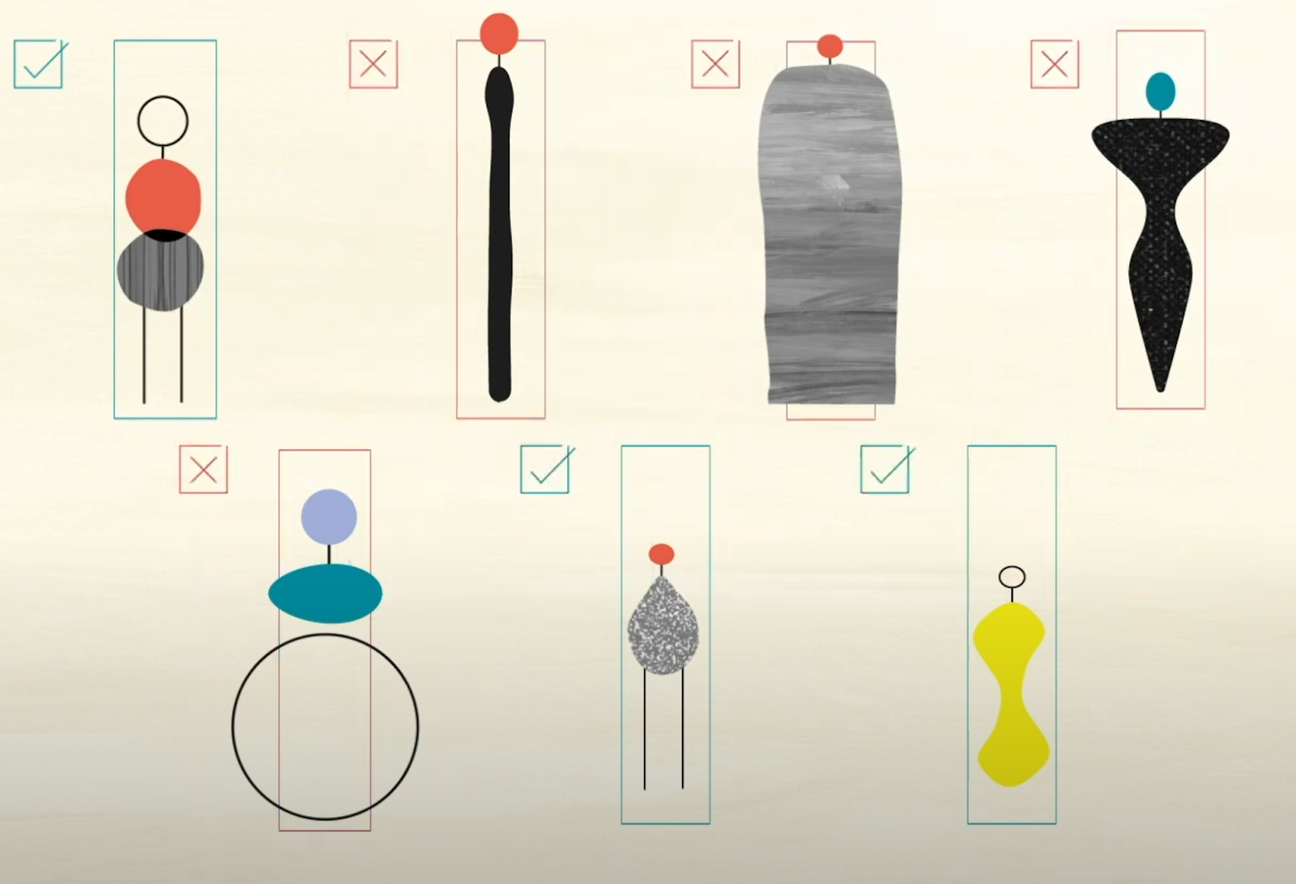
Research quality is too often assessed based on narrowly set quantitative indicators
Notes:
Research quality is too often assessed based on narrowly set quantitative indicators related to grant capture or publications, leading to a hyper-competitive environment and a poor culture

Slide 4
Publications
What we value in research
Invited talks
Awards & prizes
Successful grants
Leadership
Management
Integrity, openness, transparency
Building collaborations
What research needs
Team-working
Panels & committees
Inclusivity
Peer review
Participatory research
Mentorship & supervision
Societal impact
Notes:
There is growing recognition that researchers should be rewarded for a broader set of activities that contribute to excellent research and innovation

Slide 5
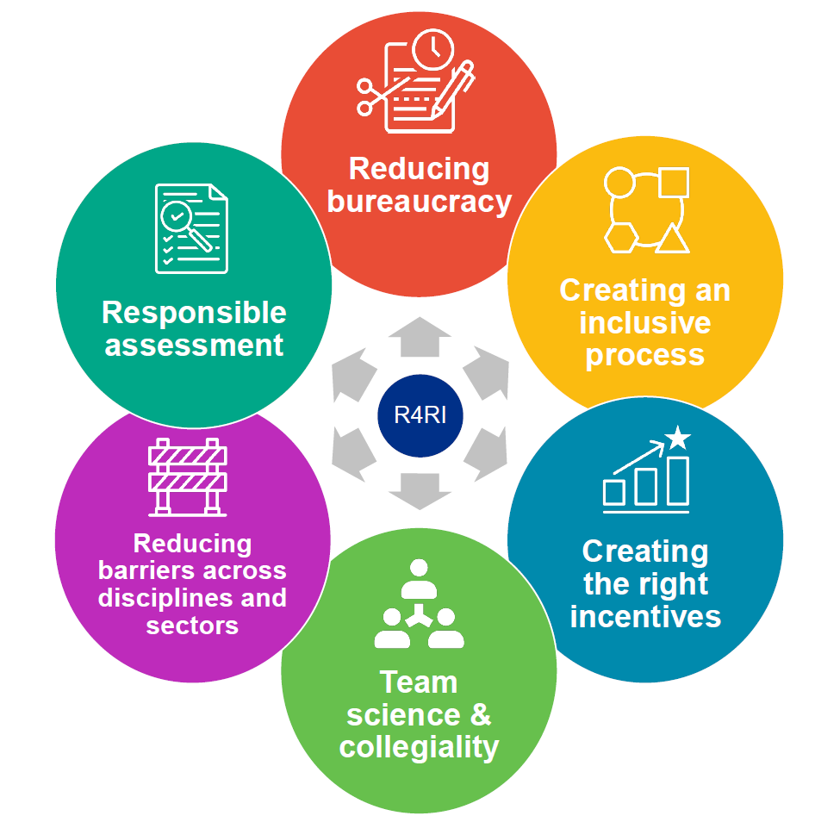
Narrative CV: diversifying what we value
The narrative CV provides a structured yet flexible format that prompts a description of contributions and achievements that reflect a broad range of skills and experience
Advantages
Rewards a broader set of activities
Values diverse contributions & career paths​
Improves diversity & inclusion​
Encourages responsible use of metrics
It allows you to tell your story
Image credit: UKRI
Notes:
Narrative CVs provide a structured, but flexible, format that is more inclusive of a wider range of contributions to research. It can allow for a better description of varied career pathways, and enables a broader range of people, ideas, and outputs to be highlighted.

Slide 6
Which funders?
UK Research and Innovation
Wellcome Trust
Royal Academy of Engineering
NIHR
Cancer Research UK
British Heart Foundation
Alzheimer’s Research UK
Leverhulme Trust
Science Foundation Ireland
Health Research Board, Ireland
Academy of Medical Sciences
Swiss National Science Foundation
Wellcome Sanger Institute
And more…!
https://www.ukri.org/what-we-offer/supporting-healthy-research-and-innovation-culture/research-and-innovation-culture/joint-funders-group/

Slide 7
Narrative CV: key features
Researchers frame their contributions with respect to how they have contributed to:
1. The generation of knowledge
3. The wider research community
2. The development of individuals
4. Broader society
https://www.ukri.org/apply-for-funding/improving-your-funding-experience/introducing-a-better-way-for-you-to-evidence-your-contributions/

Slide 8
Where should I start?
Check the funder instructions and template
Use the Guide developed with research support professionals in Oxford
As a rough guide, aim for the CV to be under 1,000 words
Allow time: it will take a day or more to write your narrative CV for the first time

Slide 9
Principles for writing a Narrative CV
Be selective: quality over quantity
Include evidence: describe outcomes
Think broadly: use examples from beyond academia
Your career context: what you did with the opportunities that were available to you
Early career?
Don’t worry!
Assessors will look at the CV as a whole and consider career stage
OK for sections to be empty or have few examples
Notes:
Don’t overwhelm reviewers with long lists, or dilute the communication of your key achievements.
Think about your strongest contributions, and those that are most relevant to the funding call you are applying for.
Focus on what you have achieved rather than what you plan to do in the future.
Provide evidence: When choosing material to include, think about how you are going to evidence quality and importance. Describe outcomes, and how you enabled them, rather than just stating activities. You can include both qualitative and quantitative evidence.
Provide context: Unlike a traditional CV, a narrative CV allows you to explain how the activities enhanced your skills or were important at your career stage, and the rationale for undertaking those activities.
Question: I am at an early stage of my research career and I don’t have many examples to include. What should I do?
Answer: The assessors should take your career stage into account. State how long you have been working in research or in a particular field or role, so it is easy for them to assess your achievements in context. You could use examples from outside of academic research, such as leadership or mentoring others in a different sector or a voluntary context. It is OK for some Modules to be short or empty.
Evaluation: Your narrative CV will be used to inform the overall assessment of a proposal or application. Assessors should not be asked to score individual modules. Therefore, leaving a module empty or with little information should not be detrimental. The balance of material in a CV will look different depending on discipline or career stage.

Slide 10
Module 1: generation of new ideas, tools, methodologies or knowledge
Your outputs, e.g.:
Research publications (may include thesis)
Policy publications, conference publications
Data sets, software, code, protocols, materials
Products (e.g. commercial, entrepreneurial, industrial, educational)
Evidence synthesis
Patents, designs
Artefacts
Exhibitions, audio or visual media
Development of methods, tools or resources
Generation of new ideas and hypotheses
Funding
Awards you have received or other forms of peer recognition, such as invited talks.
Save space
Use digital object identifiers (DOIs)
Remember to describe
Your specific contributions to each output (e.g. CRediT)
How your involvement in an output came about
Avoid
Uninformative metrics e.g. productivity or journal-based metrics (e.g. impact factors), when describing the quality of your track record
Notes:
the lists provided here of types of contributions you can consider for each module may not be exhaustive, and also that you are not expected to have made all these types of contribution.

Slide 11
Evidence, not lists
“Since 2015, I have published 6 first-author articles, mainly in high-impact journals.”
vs
“My research has contributed to a revised understanding of [phenomenon / observation A] through an in-depth an︎alysis of the effects of [B & C] on health outcomes. The work is reported in the pre-registered and openly accessible output [D; doi]"
This Photo by Unknown Author is licensed under CC BY-SA-NC

Slide 12
Module 2: development of others and maintenance of effective working relationships
Supervision or mentoring
Project management or line management, critical to the success of a team or team members.
Strategic leadership shaping the direction of a team, organisation, company or institution.
Formal teaching could be included if it focused on the development of others and is relevant to your application.
Establishing or driving collaborations or networks; contribution to team-working.
Provision of development opportunities including training, events, rewards, or recruitment strategies.
Early career?
Even if you didn’t have a leadership role, how did you contribute to the success of a team or the development of others?
Supervision or mentoring
Go beyond a number, e.g. how did you help people to develop and what did they go on to achieve?
Notes:
the lists provided here of types of contributions you can consider for each module may not be exhaustive, and also that you are not expected to have made all these types of contribution.

Slide 13
Module 3: wider research and innovation community
Activities across disciplines, institutions, and/or countries
Editing and reviewing
Committee work within your organisation and beyond
Positions of responsibility
Activities that have contributed to the improvement of research integrity or cultures, including equality, diversity and inclusion practices
Influencing a research or innovation agenda
Contributions to professional bodies
Organisation of community events, such as conferences or workshops
Contributions to open research, active sharing of knowledge and skills, community resources
More than a list of roles
Describe the importance of your contributions to the community and your career
Module 3 vs Module 4
Contributions to wider society go in module 4
Notes:
the lists provided here of types of contributions you can consider for each module may not be exhaustive, and also that you are not expected to have made all these types of contribution.

Slide 14
Module 4: broader research/innovation-users and audiences and towards wider societal benefit
Knowledge exchange, bringing together researchers, users of research and wider groups and communities to exchange ideas, evidence and expertise.
Policy engagement and development
Partnerships with business, industry, healthcare, and so forth
Public engagement with research (PER) and public understanding
Patient and public involvement (PPI)
Commercialisation
Participatory research
Responsible research and innovation (RRI)
Actions to ensure research reaches and influences relevant audiences
Who benefitted?
Describe the beneficiaries, scale and depth
Check funder differences
This module may not be included; you could put examples elsewhere e.g. in 1 or 3
Notes:
the lists provided here of types of contributions you can consider for each module may not be exhaustive, and also that you are not expected to have made all these types of contribution.

Slide 15
Optional section: Additions
Describe factors that provide context
e.g. Career breaks, impact of the pandemic, part-time working
Check funder guidance
May be seen by reviewers:
Focus on how the issue has affected your career, and how you handled any challenges

Slide 16
Example structure
Module X – Contributions to….
Summary sentence: the main message that you want a reviewer to notice
Strongest examples 1, 2, 3 etc. What you did and why it is important, with evidence. In paragraphs or bullet points.
…
…
Brief mention of additional contributions that are relevant
Worried about language?
Focus on stating what you have done and why
The examples are more important than the choice of words
Notes:
Summary sentence: start with the main message that you want a reviewer to notice, or refer back to, which could be a unifying theme of the examples that follow.
Succinct descriptions of your strongest contributions: what you did and why it is important, with evidence. This could be in sentences or bullet points. You could group entries that are supported by the same evidence.
Sentence summarising additional contributions: end with a brief mention of other activities or contributions that you do not have space to describe fully but you feel are important for this funding application.

Slide 17
Writing a Narrative CV: step by step
1. Create a long list of activities you could include in each module
2. Highlight the strongest and most relevant, referring to the funding call
3. Identify the significance and evidence for highlighted activities
4. Move examples between modules if needed
5. Draft a summary sentence to open each module: what do you want a reviewer to remember?
6. Draft the text for each module (see slide 16)
Notes:
Using the prompts in the template below, make a list of the activities you could include in each of the four modules.
In your long list, highlight the entries that are most relevant to the funding call.
For each of your highlighted entries, jot down evidence of their significance: this could be quantitative (e.g. ‘this was the largest collection of its type’) or qualitative (e.g. quotes). Referring to your funding call might help you to identify your strongest activities.
Check for overlap between the lists in each module, and move any entries that fit better in a different module.
Look at your selection for each module and think of the most important point that you would want a reviewer to remember. Try to summarise that point in a sentence or phrase.
Now you have the material you need to write a first draft for each module. You can use the suggested writing structure described in ‘Completing the Modules’.

Slide 18
Team CVs – principles
A single narrative CV for a team, e.g. used by UKRI
Guide to suggested steps for team leads
Length limit may be slightly increased compared to individual CV
Skills and experience needed – collectively – by the team to deliver the project, i.e. a ‘showcase’
Roles within the team: show suitability of the individual
E.g. Successful leadership of complex or collaborative projects for the Project Lead(s)
E.g. Strong examples of supporting career development for Training Lead
Focus on what is needed for the specific project
The best examples may not be the default ‘top’ achievements from the standard academic CVs

Slide 19
FAQ
Is the Narrative CV here to stay?
In all likelihood, yes, both nationally and internationally. UKRI have indicated that they will use the Narrative CV in all funding schemes from early 2024. Universities are already starting to use the Narrative CV in recruitment and promotion too.
Does all the Narrative CV need to be provided in prose?
No, it’s not necessary to use the narrative format throughout. See slide 16 for suggestions.
How will the Narrative CV be assessed?
This varies by funder, but reviewers are asked to assess the CV as a whole rather than individual modules.
Are there libraries of successful Narrative CVs?
Not at the moment, as it’s too early to identify good examples. Also, exemplar CVs might encourage applicants to follow the model descriptions rather than focus on documenting their individual track record.
Poll
What is your current level of awareness of the narrative CV?
How prepared do you feel to start writing your narrative CV?​

Slide 20
Resources
Oxford Narrative CV webpage – COMING SOON
Research facilitators in your department or division
University of Glasgow online course on writing Narrative CVs
University of Cambridge training resources, including video
UKRI guidance

Slide 21
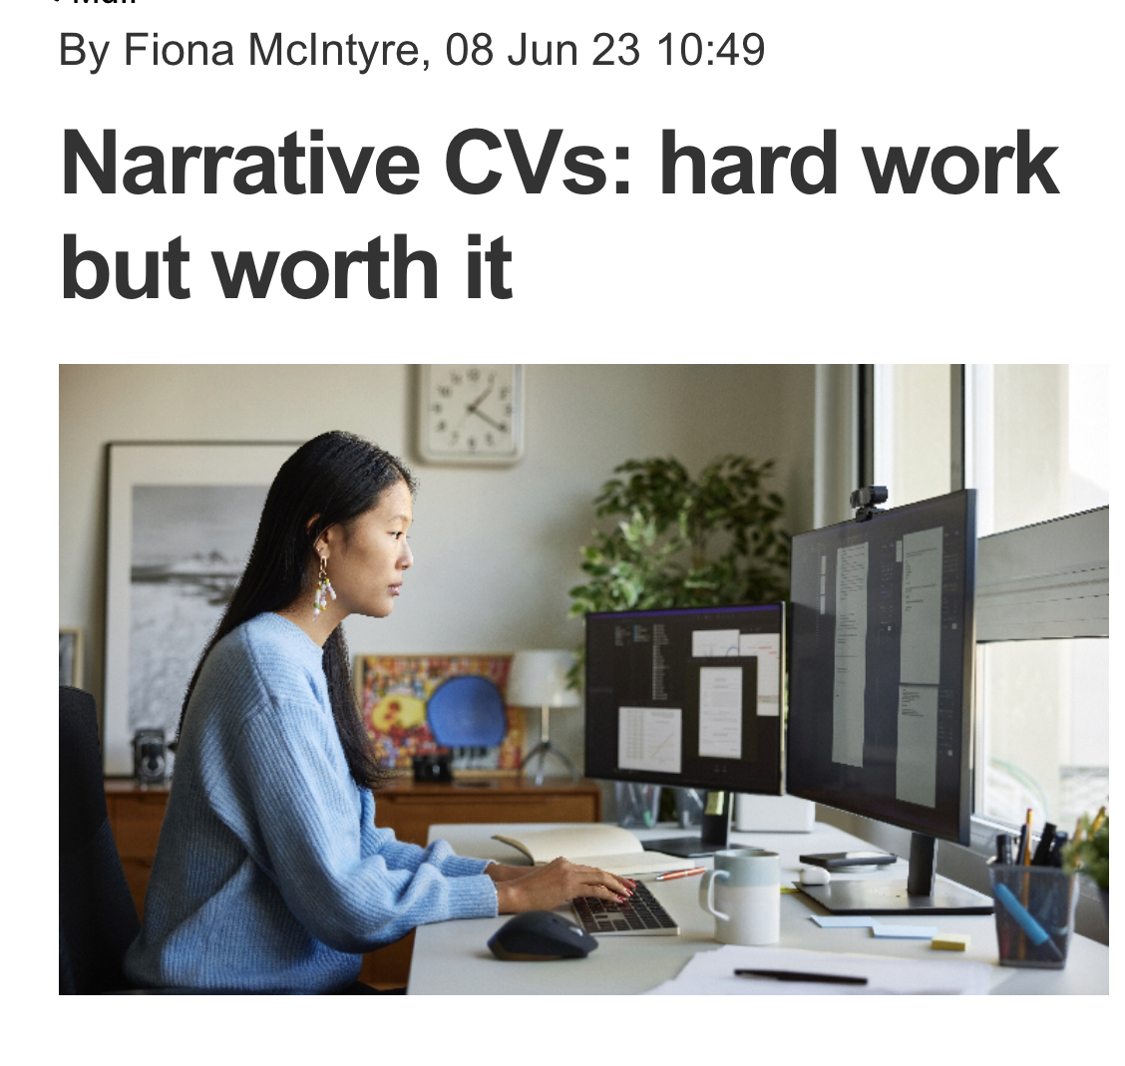
Questions and feedback
Feedback on this session? MS Forms link will be shared by email and added to the chat.
Feedback on using the guide? Use the link in the writing Guide to provide suggestions to improve the Guide and to develop future training
Contact us:
Mary Muers mary.muers@medsci.ox.ac.uk
Tanita Casci Tanita.Casci@admin.ox.ac.uk
Notes:
End recording

